Slide 1

DD Month YYYY
Enhancing Attention in 360° Educational Videos:
Real-Time Guidance & Heatmap Feedback
Author: Yuanchao Lu
First Supervisor: Dr. W.O. (Wolfgang) Hürst
Second Supervisor: Dr. C. (Christof) van Nimwegen

Slide 2
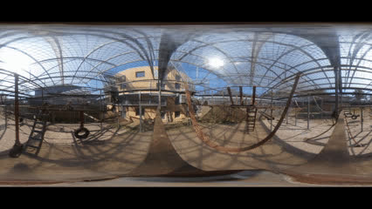
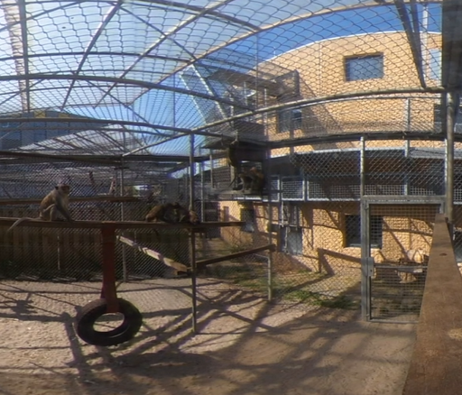

Why do we need guidance in 360° VR learning?
Immersive but Missable
Look anywhere
Miss important content
FOMO & Overload
Cause anxiety or cognitive overload
Over-scan & Under-explore
Learning Impact
Unable to catch the main point
Can’t absorb the intended lesson content

Slide 3
Research Contributions & Overview
Guided VR Learning System - a 360° video player
dual-axis progress bars
POI markers
real-time heatmap feedback
User Study: Participants in two conditions (with vs. without guidance cues) to measure attention, experience, and learning outcomes.
Key Findings:

Slide 4
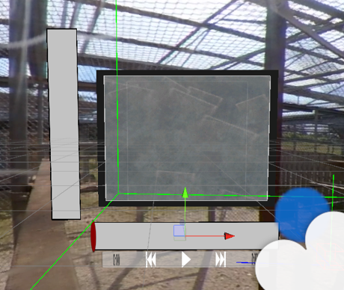


Proposed Solution: Guided 360° Video Interface
Dual-Axis Progress Bars:
horizontal for pitch
vertical for yaw
POI Indicators:

Slide 5
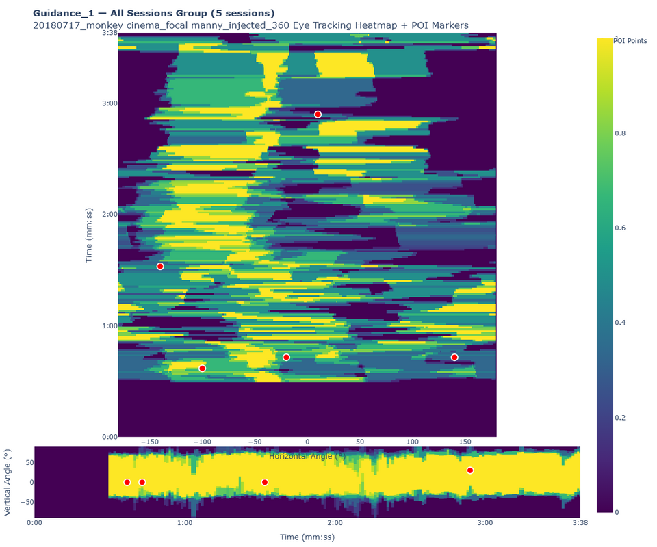
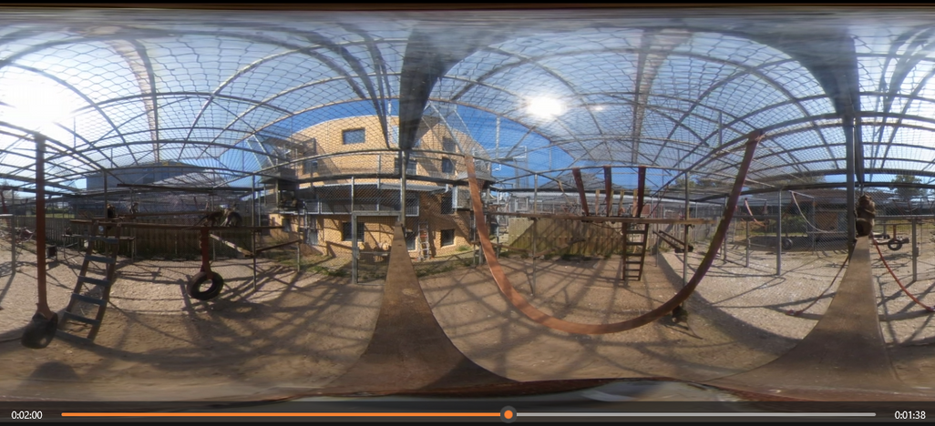
Proposed Solution: Guided 360° Video Interface
Personalized Heatmap Feedback:

Slide 6
Pilot Study Insights & Iterations
Pilot Test: a pilot with 12 participants to evaluate the interface’s usability and clarity.
Overall Usability: average usability ratings ~3.0–4.0 out of 5.
Noted Confusions:
UI blocks the view
confusion about the bars’ orientation mapping and position
The meaning of POI dots
Heatmap not ‘real-time’
Positive Feedback:
Like the guidance cues
Help to explore the full 360° space.

Slide 7
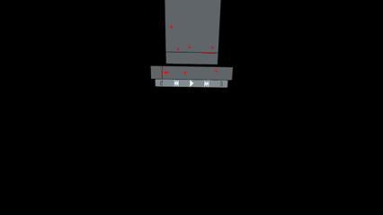
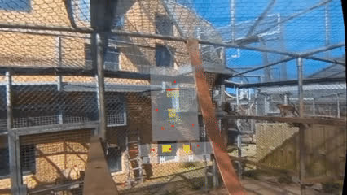
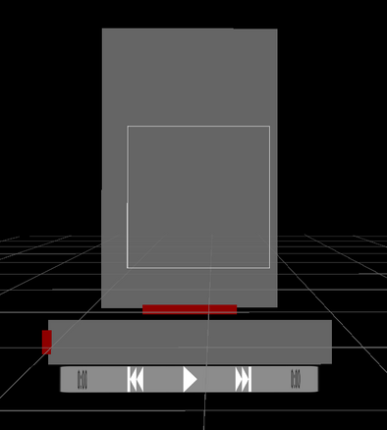
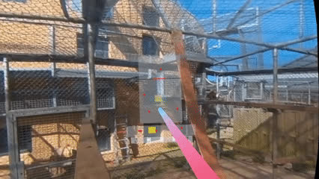
Pilot Study Insights & Iterations
Improvements Made:

Slide 8
Research Questions
RQ1: Does real-time guidance increase how much of the important content students actually see?
RQ2: Does guidance lower perceived mental effort and reduce the fear of missing out during learning?
RQ3: Does real-time heatmap feedback improve students’ awareness of what they missed?
RQ4: Do these tools lead to better immediate learning performance after watching the 360° video?

Slide 9
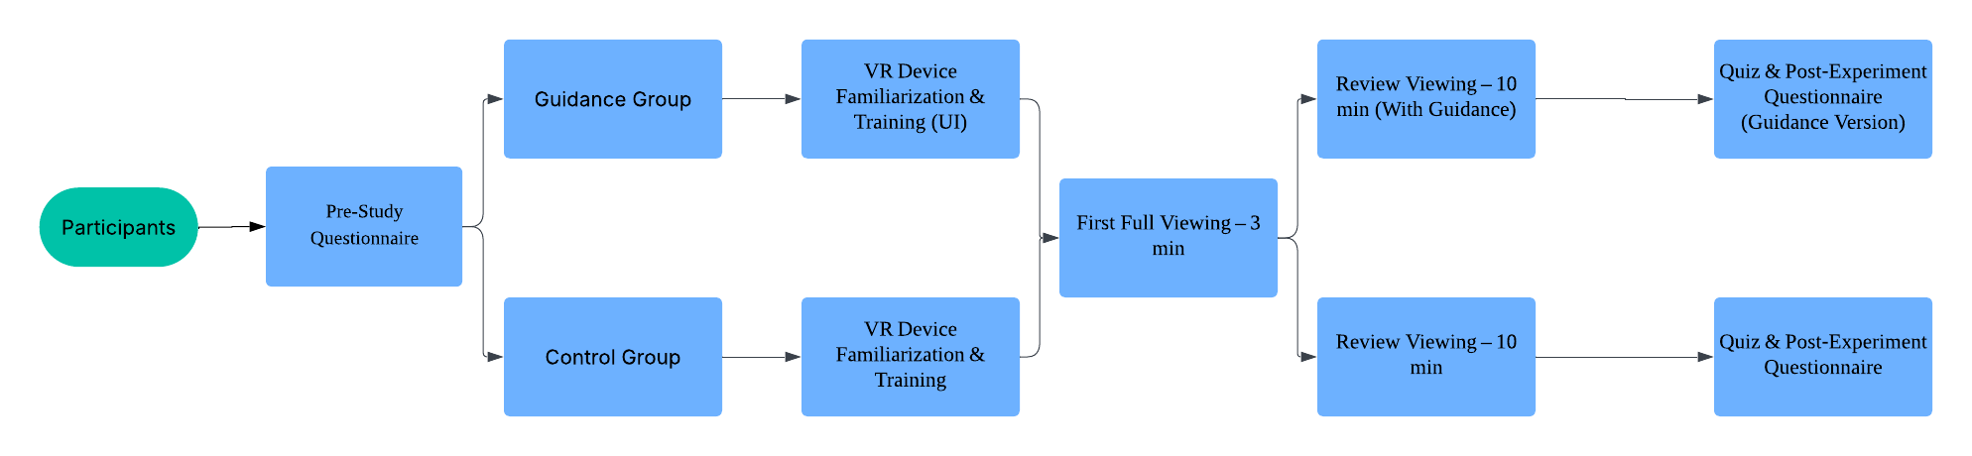
Study Design & Procedure
Participants: 20 university students (randomly assigned)
Study material: a 3-minute Observational Video
Apparatus:
Oculus Quest VR headset with custom 360° video player
Fixed chairs

Slide 10
Data Collection
Pre-Questionnaire: Baseline info & VR Experience
Head-Tracking Logs: {points{time, angle}, videoName, DateTime, angleType, videoDuration, username, fov}
Quiz: Immediate comprehension quiz (50% focusing on POIs)
Post-Experience Questionnaire:
user experience (Likert-scale ratings)
Cognitive load (a simplified NASA-TLX)
FOMO (Yamaguchi et al.)
Engagement & Presence (IMI)
Usability and usefulness of the guidance interface (SUS)

Slide 11
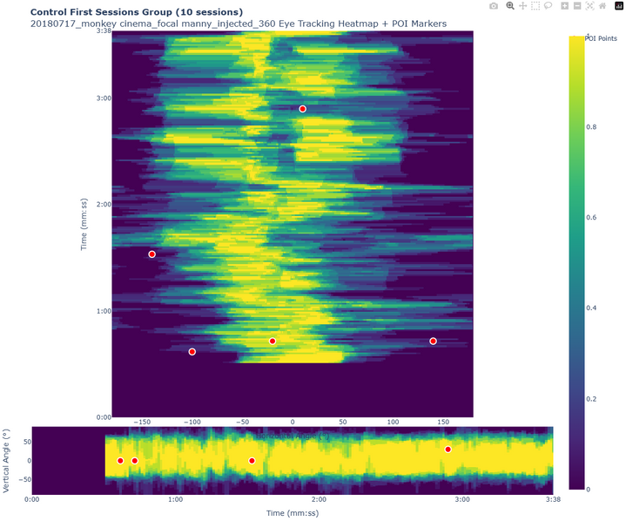
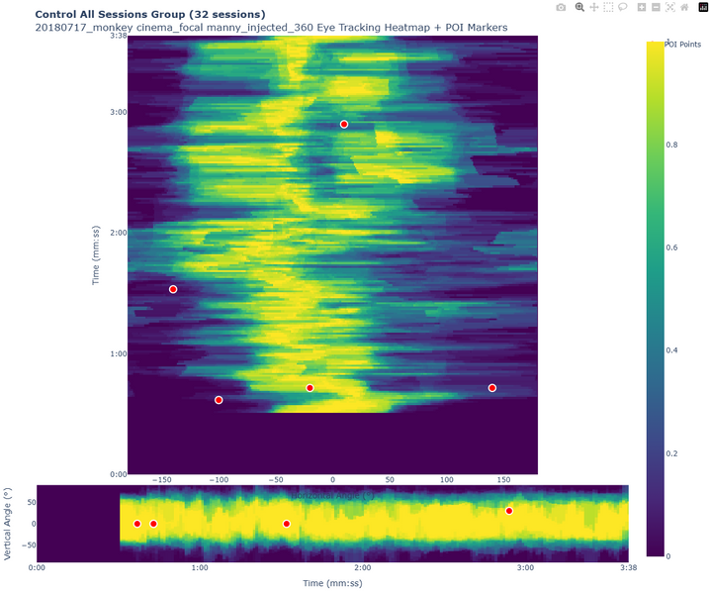
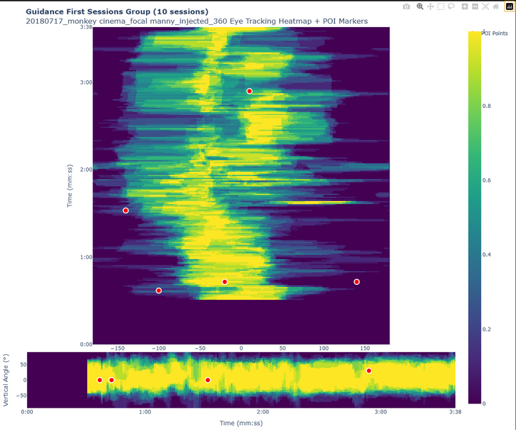
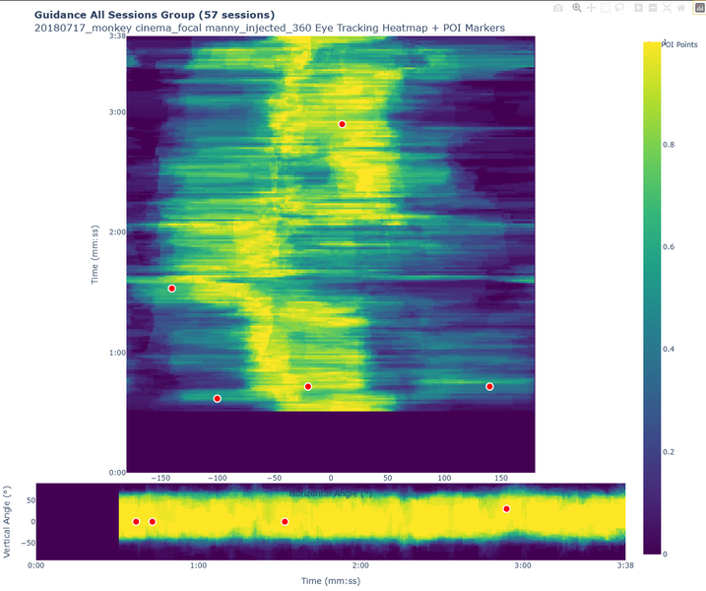
Results: Attention Coverage

Slide 12
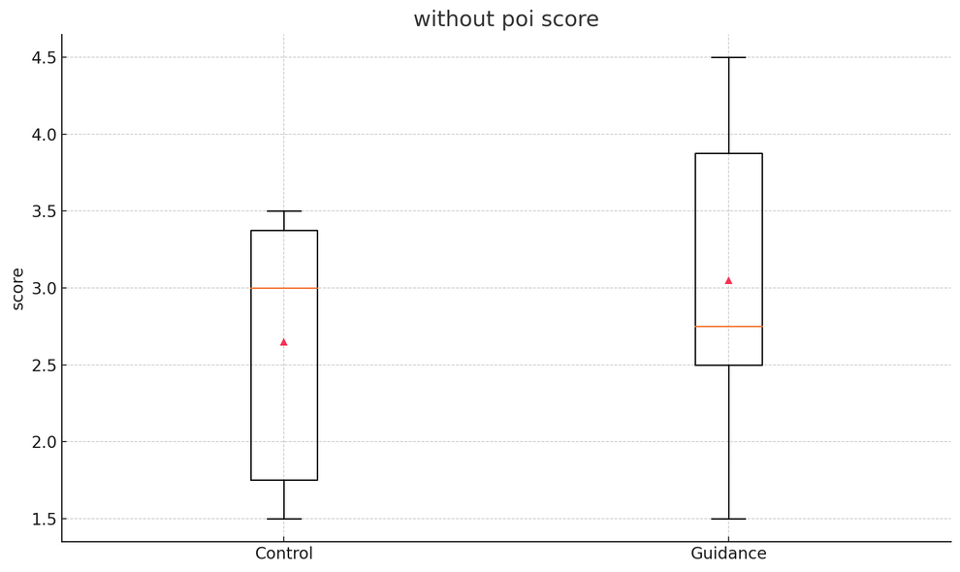
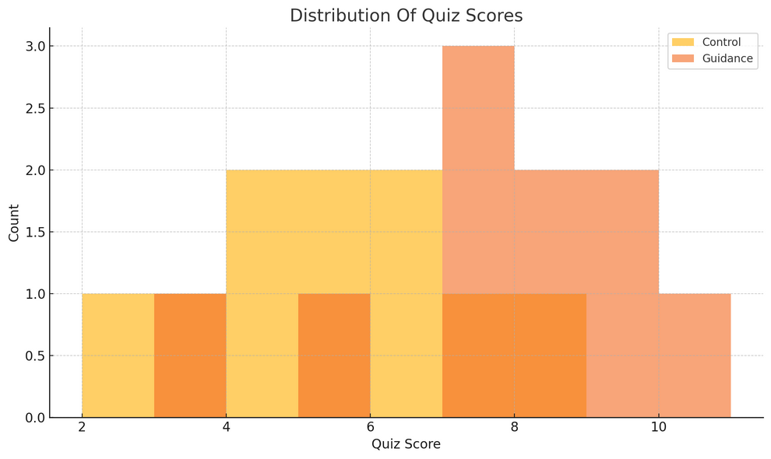
Results: Learning Performance (Quiz)
Quiz scores:

Slide 13
Results: User Experience (Cognitive Load & FOMO)

Slide 14

Thanks!

